Slide 1



Med Patient Portal Web Application

Slide 2


Presented By:
Bhargav Abhinay Reddy
L20563976
bmadhira@lamar.edu
Venkata Harun Ganta
L20565959
vganta@lamar.edu
Praveen Raja Neerukonda
L20568108
pneerokonda@lamar.edu

Slide 3

TABLE OF CONTENTS
01
Abstract
04
Methodology (Design & Implementation)
02
Introduction
05
Testing Evaluation
03
Related Work
06
Conclusion & Futurework

Slide 4
Abstract
The Med Portal Web Application is a groundbreaking solution for streamlining hospital administration and improving patient care.
It offers a range of key features, including:
-> Efficient patient management with tools for record-keeping and Tracking.
-> Appointment scheduling to the selected Doctors based on flexible dates.
-> Simplified staff management for better resource allocation.
-> Pharmacy management module ensuring medication safety and Order tracking.
Security is paramount, with strict measures in place for data protection and regulatory compliance.

Slide 5

Security is paramount, with strict measures in place for data protection and regulatory compliance.
The system also enhances administrative efficiency with streamlined billing, insurance claims, and financial operations.
Overall, the Med Portal web application empowers healthcare providers, prioritizes patient-centric care, and readily adapts to the evolving demands of the healthcare industry.

Slide 6
Introduction
The Med Portal is a pivotal tool in modern healthcare administration, bridging the gap between creativity and compassion to ensure high-quality patient care and operational efficiency.
By integrating various departments and processes within healthcare facilities, including staff and pharmacy management, patient care, security compliance, insurance tracking, financial processes
It provides a unified platform for streamlined operations. Acting as the digital backbone of healthcare facilities, it centralizes essential data and resources, enabling organizations to meet evolving patient and regulatory demands effectively.
Empowers healthcare companies to navigate the complexities of the healthcare landscape confidently and compassionately, promoting innovation and excellence in healthcare delivery.

Slide 7
Computer Science Principles:
The entire project is divided into two applications involving both Frontend (Graphical User Interface) and its Backend Service.
Front End:
-> Html (Hyper Text Markup Language)
-> CSS (Cascading Style Sheets)
-> Typescript
-> Angular (Framework to Achieve Single Page Application)
Backend:
-> Spring Boot Using Java (J2EE).
Database:
-> MySQL (Relational Database management System)

Slide 8
Related Work
In related work for developing this Web Application Med patient Portal, we have done a literature survey on some related info:
1. Existing Patient Portals:
Review features, interfaces, and security of other portals.
2. Research Papers:
Analyze academic studies on patient portals, healthcare informatics, and user experience.
3. Industry Standards:
Study guidelines from live Industry organizations.
4. Regulatory Compliance:
Ensure compliance with Angular Guards and other regulations for data privacy and security.
5. User Feedback:
Consider case studies and feedback from existing portal users.
6. Technological Trends:
Stay updated on emerging tech like blockchain, telehealth integration, and interoperability standards.

Slide 9
System Architecture
The application flow for a web application built using Angular as the front-end framework, Spring Boot as the back-end framework, and MySQL as the database using the JDBC Template for data access.
1. Client-Side Flow:
The user interacts with the Angular Single Page Application (SPA) by accessing it through a web browser.
Angular handles the presentation layer of the application, rendering dynamic user interfaces and managing client-side logic.
2. Server-Side Flow:
Spring Boot serves as the backend of the application, handling HTTP requests from
the Angular SPA and processing business logic.
3. Data Base Interaction:
The JDBC Template in the Spring Boot application establishes a connection to the MySQL
database using the JDBC driver

Slide 10
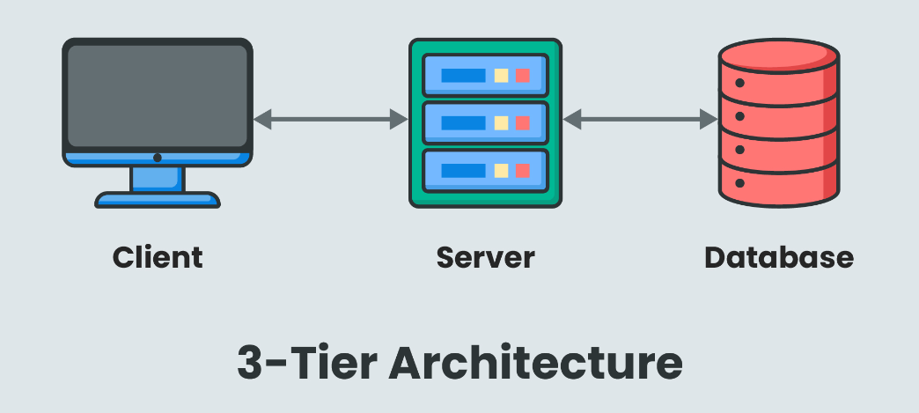
System Architecture Interaction

Slide 11
Methodology
The Med Patient Portal Web Application is typically designed with various features to handle various departments like Administrative, Clinical, Medical, Laboratory, and Operational Processes.
Patient:
1. The patient can be able to register to the portal.
2. The patient can be able to log in with the username provided in the Email.
3. After Login, they can Edit the Patient profile
4. View / Search Doctors.
5. View / Book Appointment based on Selected Doctor.
6. Pharmacy management of adding medicines to the cart and ordering online.

Slide 12
Doctor:
1. With the help of the Management portal, doctors can be able to log in and access the
portal.
2. Add the timetable of the week.
3. Edit Profile
4. Change Password
5. View Patients
6. View Emergency Contacts of Patients
7. Respond to the appointment of the patient.
8. Suggest medication to the appointment request.

Slide 13
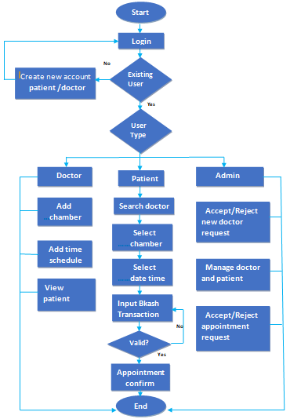
Design & Implementation

Slide 14
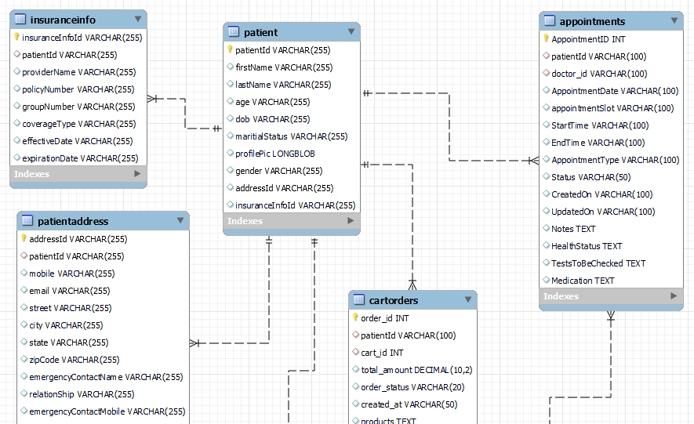
Database Entity Relation

Slide 15
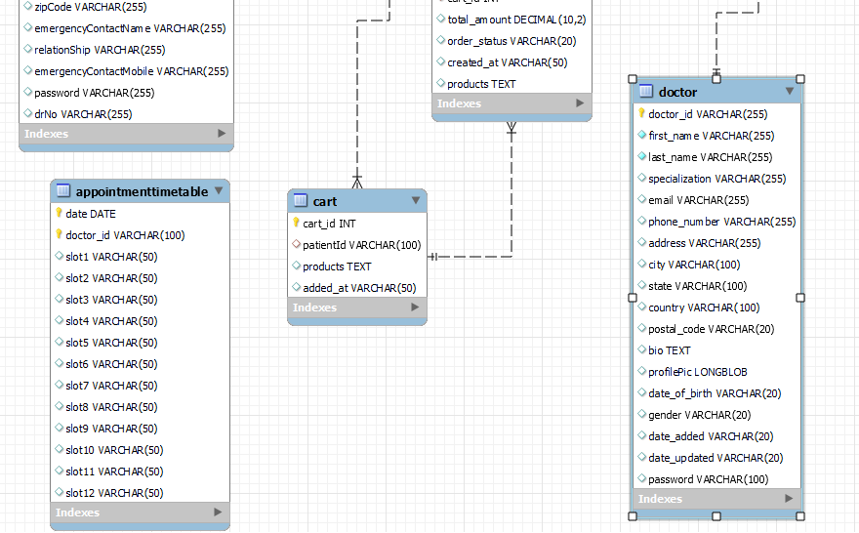
Database Entity Relation

Slide 16
Testing Evaluation
Confirming and verifying the functionality of a software application or program is known as software testing.
We tested Our Application by Manual testing which includes end-to-end flows and API testing using the Postman Testing tool.
All the HTTP APIs are tested with the help of the Postman testing tool.
Tested the Entire application end to end involving all the flows from front end to database.

Slide 17
Conclusion
Hence, we finally achieved the development, testing, and maintaining of a Med Portal System and provided services to doctors and patients in their daily lives.
This portal makes the Hospitals', and doctor's daily lives easy by providing all the main important services.
The Angular-powered Single Page Application Web portal is designed as a responsive and dynamic experience across a variety of devices.
The Backend Api interacts with the database to get and update the data as expected.
The Over application development is done by SDLC methodology.
Therefore we have achieved the development, testing, and maintaining of web application Industry Standards.

Slide 18
Future Work
• The Future work can include further development of including as many as possible services in this
development architecture.
• The Http Api’s have to be protected with an HTTPS certificate to the backend service
will provide APIs with more security.
• Based on the traffic of services and user growth if needed we can migrate the MySQL-
related database to a NoSQL database like Mongo DB, which helps in API response time
to respond faster.

Slide 19
Bibliography
•https://www.javatpoint.com/spring-boot-tutorial
•https://angular.io/
•https://www.javatpoint.com/mysql-tutorial
•https://nodejs.org/en/download

Slide 20
THANKS!

